Slide 1
Gesture Detection in Video Surveillance BTech451 Introductory Seminar
Presented by Yuan Wang

Slide 2
Presentation Overview
People involved
About the company
Project description
Hope to Achieve

Slide 3
People Involved
Project Coordinator and co-supervisor
Prof Reinhard Klette and Prof. Zezhong Xu
Industry Coordinator
TN Chan from Compucon
Students
Eric Song
Yuan Wang

Slide 4

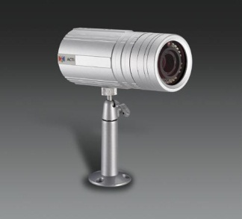
About the company
Compucon New Zealand was established in 1992
performed as an Industry Partner for University of Auckland since 2002
IP Camera CA1511 provided
Homepage: http://www.compucon.co.nz/

Slide 5
Project description
Goals
Understand selected human motion or gestures in surveillance video data
Three steps
Distinguish foreground objects
Detect people in those objects
Understand unusual movements
e.g. hands-up in Bank robbery
people laying down on ground
a special (defined) signal for raising alarm

Slide 6
Hope to Achieve
Project planning skills
Working experience in industry environment
Gaining experience with programming
Good application that works properly

